Slide 1

Preliminary ⁶⁴Zn(n,p)⁶⁴Cu and ⁴⁷Ti(n,p)⁴⁷Sc Data
Andrew Voyles
23 May 2016

Slide 2
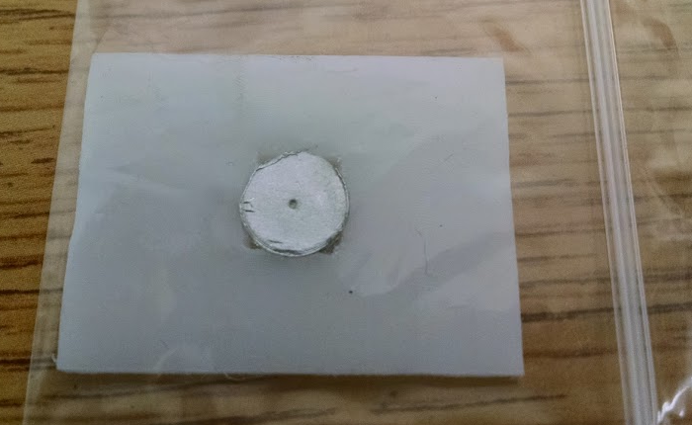
Experimental Setup – 03 Nov 2015
Zinc
Polyethylene
Zinc
Thickness: 1.03 ± 0.01 mm
Diameter: 9.90 ± 0.15 mm
Weight: 0.5375 ± 0.0001 g
Indium
Thickness: 0.48 ± 0.02 mm
Diameter: 9.77 ± 0.12 mm
Weight: 0.2475 ± 0.0001 g
Beam On: 2:13:16 PM
Beam Off: 5:13:16 PM
Start of Counting: 5:43:01 PM
Indium

Slide 3
336 keV - 115m In IT Decay
391 keV - 113m In IT Decay
417 keV - 116 In β- Decay
511 keV - 64 Cu β+ Decay

Slide 4
Q_{β} = 3.278 MeV

Slide 5
Experimental Setup – 25 Feb 2016
Titanium
Polyethylene
Titanium
Thickness: 1.03 ± 0.01 mm
Diameter: 9.9034± 0.15 mm
Weight: 0.337 ± 0.0001 g
Indium
Thickness: 0.48 ± 0.02 mm
Diameter: 10.136 ± 0.12 mm
Weight: 0.2475 ± 0.0001 g
Beam On: 1:40:35 PM
Beam Off: 4:57:52 PM
Start of Counting: 5:47:59 PM
Indium

Slide 6
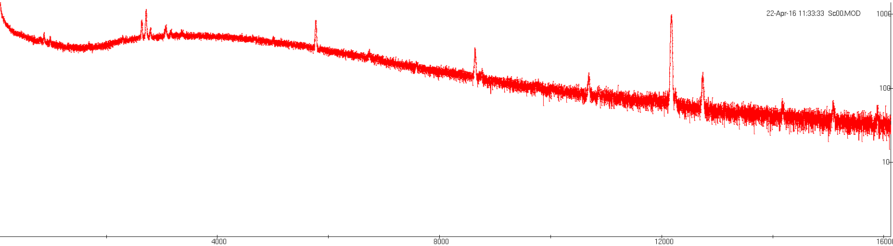

Slide 7

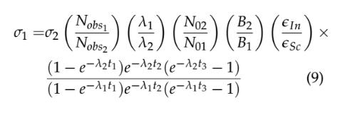
Model

